Slide 1
A* search

Slide 2
Outline
In this topic, we will look at the A* search algorithm:
It solves the single-source shortest path problem
Restricted to physical environments
First described in 1968 by Peter Hart, Nils Nilsson, and Bertram Raphael
Similar to Dijkstra’s algorithm
Uses a hypothetical shortest distance to weight the paths

Slide 3
Background
Assume we have a heuristic lower bound for the length of a path between any two vertices
E.g., a graph embedded in a plane
the shortest distance is the Euclidean distance
“as the crow flies”
use this to guide our search for a path
“as the fox runs”

Slide 4
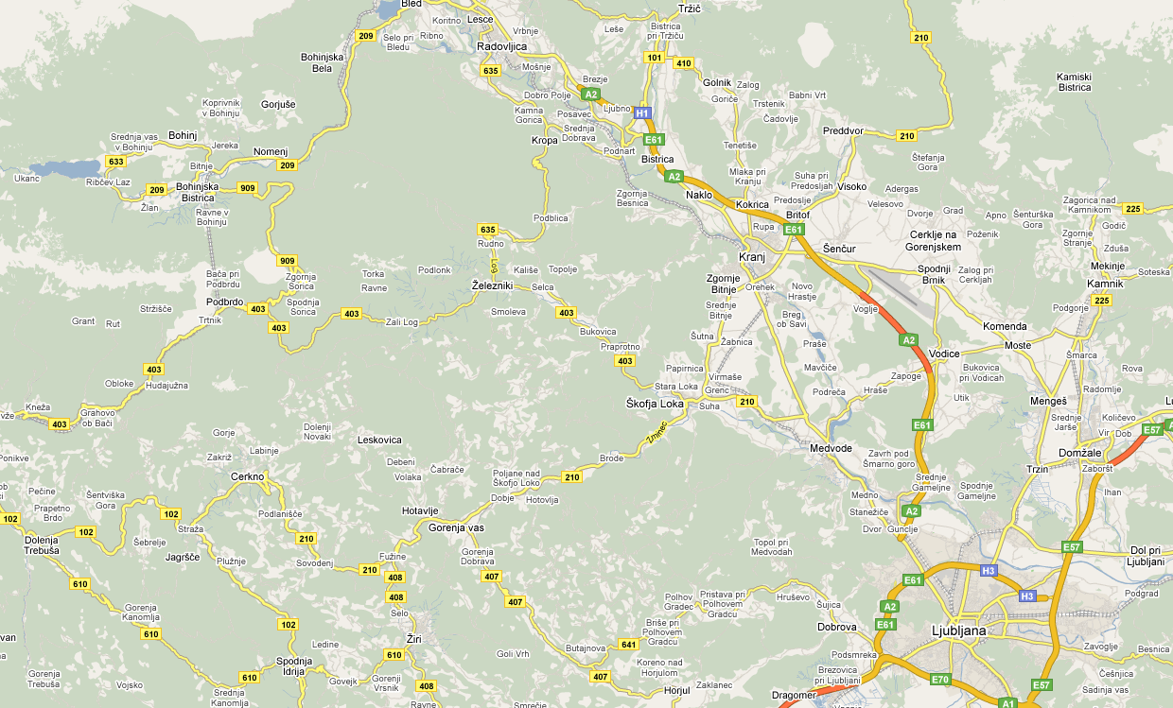
Idea
Consider this map of Slovenia

Slide 5
Idea
Suppose we want to go from Kamnik to Bohinj

Slide 6
Idea
A lower bound for the length of the shortest path to Bohinj is h(Kamnik, Bohinj) = 53 km
53 km

Slide 7
Idea
Any actual path must be at least as long as 53 km
53 km

Slide 8
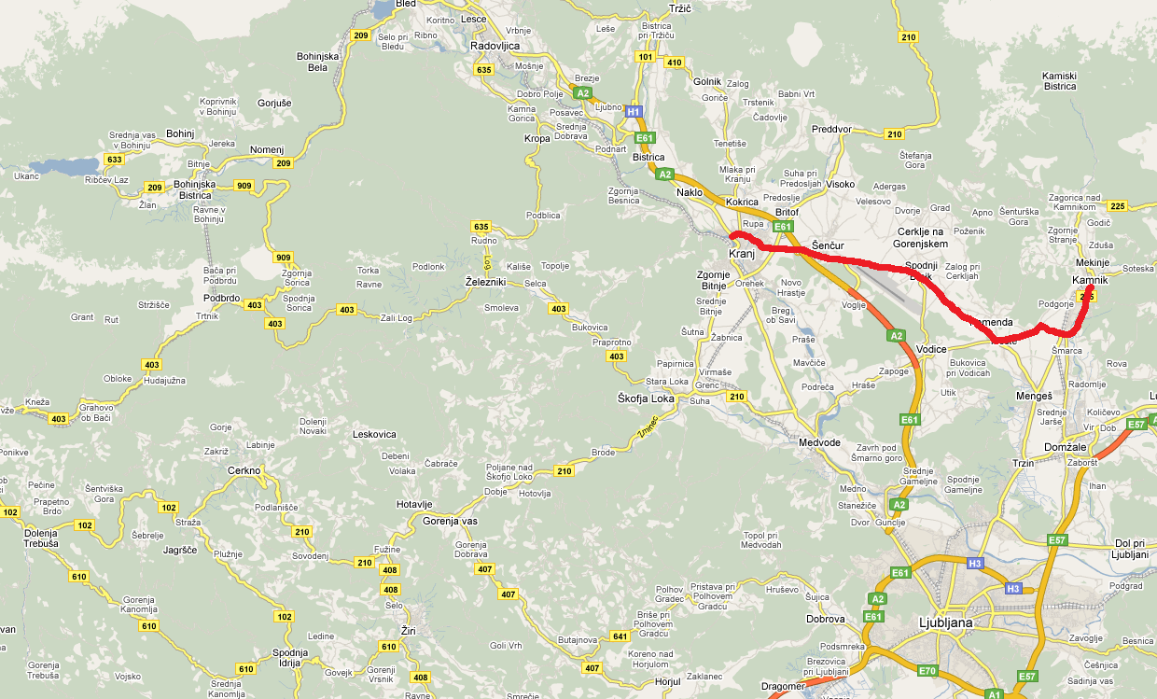
Idea
Suppose we have a 28 km shortest path from Kamnik to Kranj: d(Kamnik, Kranj) = 28 km
28 km

Slide 9
Idea
A lower bound on the shortest distance from Kranj to the destination is now h(Kranj, Bohinj) = 32 km
32 km
28 km

Slide 10
Idea
Thus, we weight of the path up to Kranj is
w(Kranj) = d(Kamnik, Kranj) + h(Kranj, Bohinj) = 60 km
32 km
28 km

Slide 11
Idea
Any path extending this given path to Bohimj must be at least 60 km
32 km
28 km

Slide 12
Idea
The value w(Kranj) represents the shortest possible distance from Kamnik to Bohinj given that we follow the path to Kranj
As with Dijkstra’s algorithm, we must start with the null path starting at Kamnik:
w(Kamnik) = d(Kamnik, Kamnik) + h(Kamnik, Bohimj)
= 0 km + 53 km
Bohimj
53 km
Kamnik

Slide 13
Algorithm Description
Suppose we are finding the shortest path from vertex a to a vertex z
The A* search algorithm initially:
Marks each vertex as unvisited
Starts with a priority queue containing only the initial vertex
The priority of any vertex v in the queue is the weight w(v) which assumes we have found the a shortest path to v
Shortest weights have highest priority

Slide 14
Algorithm Description
The algorithm then iterates:
Pops the vertex u with highest priority
Mark the vertex u of the path as visited
Ignore all visited adjacent vertices v
For each remaining unenqueued adjacent vertex v:
Push v with w(v) = d(a, u) + d(u, v) + h(v, z)
For each enqueued adjacent vertex v:
Determine if w(v) = d(a, u) + d(u, v) + h(v, z) is less than the current weight/priority of v, and if so, update the path leading to v and its priority
Continue iterating until the item popped from the priority queue is the destination vertex z

Slide 15
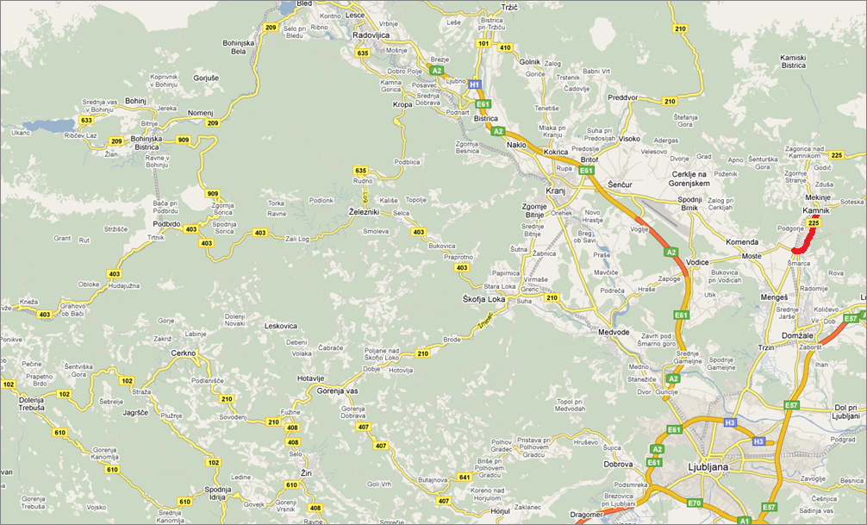
Comparison of Priorities
Suppose we have a path with
w(Smarca) = 4 km + 52 km = 56 km
52 km
4 km

Slide 16
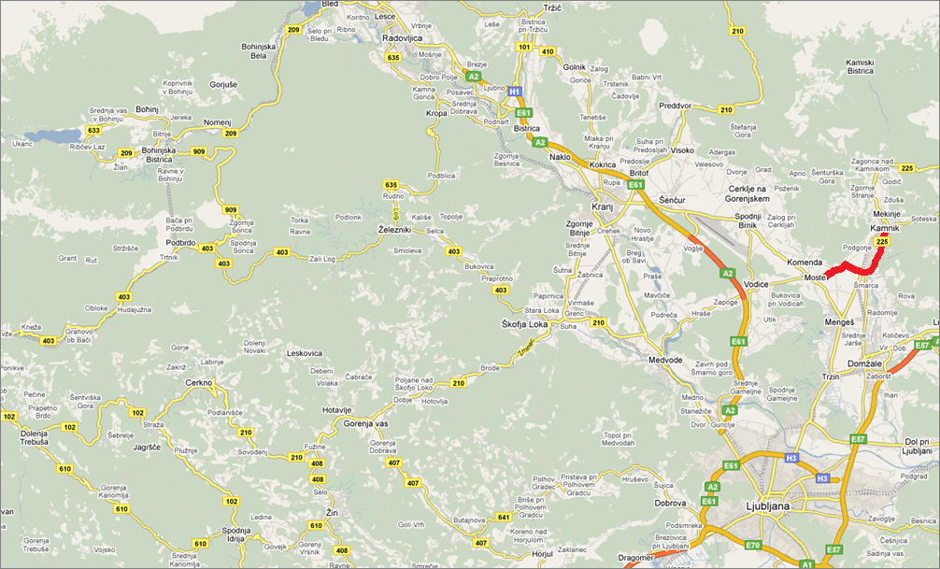
Comparison of Priorities
We can extend this path to Moste:
w(Moste) = 4 km + 5 km + 48 km = 57 km
48 km
9 km

Slide 17

Comparison of Priorities
We can also extend this path to Menges:
w(Menges) = 4 km + 4 km + 51 km = 59 km
51 km
8 km

Slide 18
Comparison of Priorities
The smaller weight path to Moste has priority—extend it first
48 km
9 km

Slide 19
Comparison with Dijkstra’s Algorithm
This differs from Dijkstra’s algorithm which gives weight only to the known path
Dijkstra would chose Menges next:
d(Kamnik, Moste) = 9 km > 8 km = d(Kamnik, Menges)
Difference:
Dijkstra’s algorithm radiates out from the initial vertex
The A* search algorithm directs its search towards the destination

Slide 20
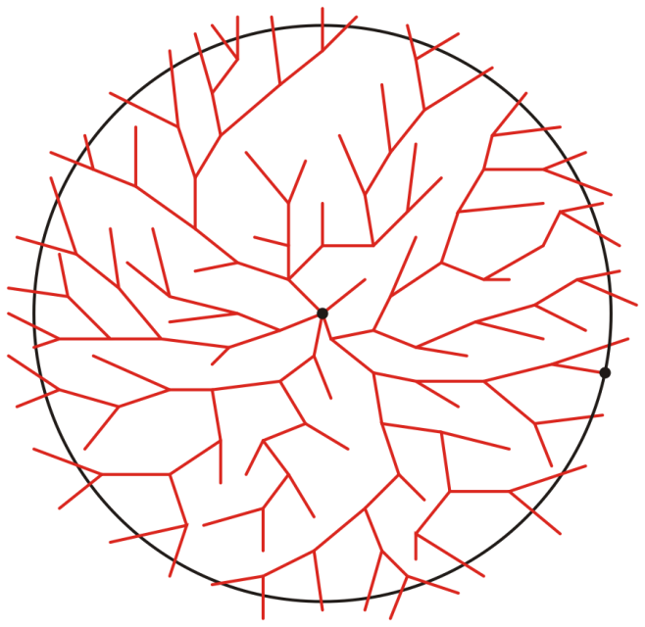
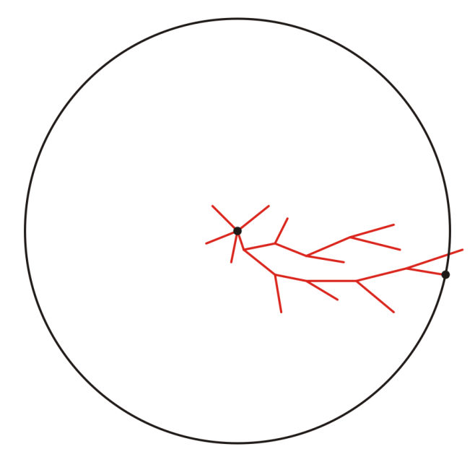
Comparison with Dijkstra’s Algorithm
Graphically, we can suggest the behaviour of the two algorithms as follows:
Suppose we are moving from a to z:
a
a
z
z
Representative search patterns for Dijkstra’s and the A* search algorithms

Slide 21
Comparison with Dijkstra’s Algorithm
Dijkstra’s algorithm is the A* search algorithm when using the discrete distance
No vertex is better than any other vertex
a
a
z
z
Representative search patterns for Dijkstra’s and the A* search algorithms

Slide 22
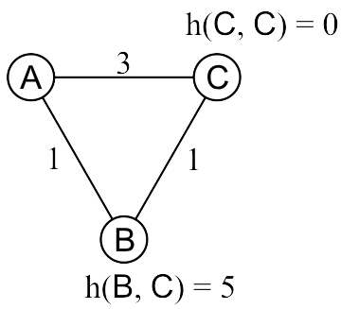
Optimally Guarantees?
The A* search algorithm will not always find the optimal path with a poor heuristic distance
Find the shortest path from A to C:
B is enqueued with weight w(B) = 1 + 5 = 6
C is enqueued with weight w(C) = 3 + 0 = 3
Therefore, C is dequeued next and as it is the destination, we are finished
Reference: Andrew Moore, Carnegie Mellon University
Notes:
22

Slide 23
Admissible Heuristics
This heuristic overestimates the actual distance from B to C
The Euclidean distance doesn’t suffer this problem:
The path the crow flies is always shorter than the road the wolf runs
Reference: Andrew Moore, Carnegie Mellon University
Notes:
23

Slide 24
Admissible Heuristics
Admissible heuristics h must always be optimistic:
Let d(u, v) represent the actual shortest distance from u to v
A heuristic h(u, v) is admissible if h(u, v) ≤ d(u, v)
The heuristic is optimistic or a lower bound on the distance
Using the Euclidean distance between two points on a map is clearly an admissible heuristic
The flight of the crow is shorter than the run of the wolf
Notes:
24

Slide 25
Optimality Conditions
The effectiveness of the A* search algorithm depends on the heuristic h(v)
Can be shown to run in polynomial time if
|h(u, v) – d(u, v)| = O(ln(d(u, v)))
where d(u, v) is the length of the actual shortest path
I.e., doubling the length of the optimal solution only increases the error by a constant
Not likely with a road map and the Euclidean distance

Slide 26
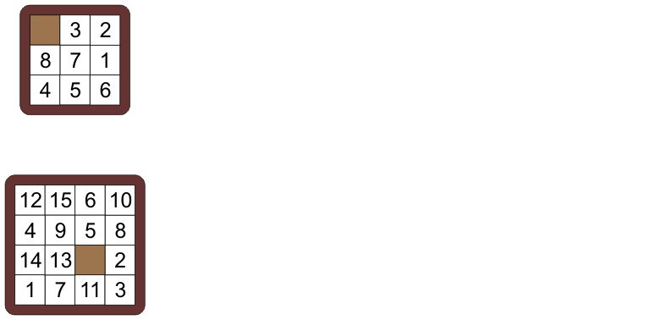
The N Puzzle
Consider find the solution to the following puzzle
Take a random permutation of 8 or 15 numbered tiles and a blank formed in a rigid square
Reference: Andrew Moore, Carnegie Mellon University
Notes:
26

Slide 27
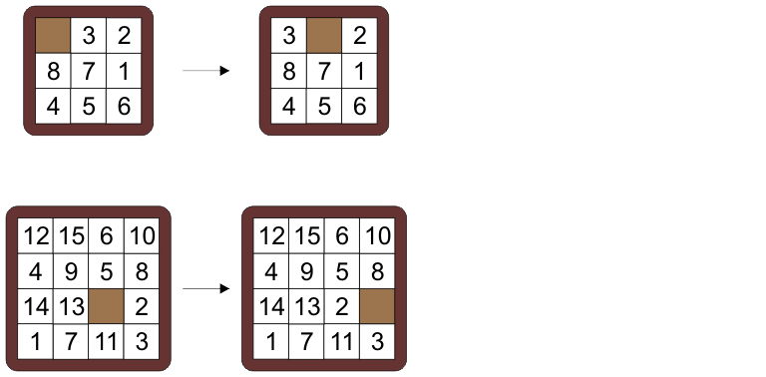
The N Puzzle
You are allowed to move a tile adjacent to the blank into the location of the blank
Notes:
27

Slide 28
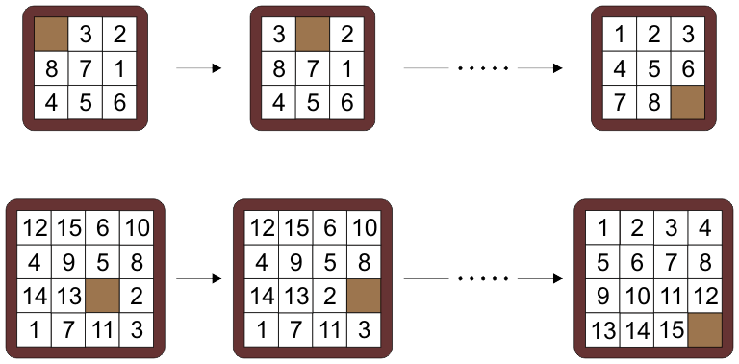
The N Puzzle
The objective is to find a minimum number of moves which will transform the tiles into a standard solution
Notes:
28

Slide 29
The N Puzzle
There are 9! and 16! initial permutations
Half of these, through a sequence of moves, can be transformed into the desired solutions
Notes:
29

Slide 30
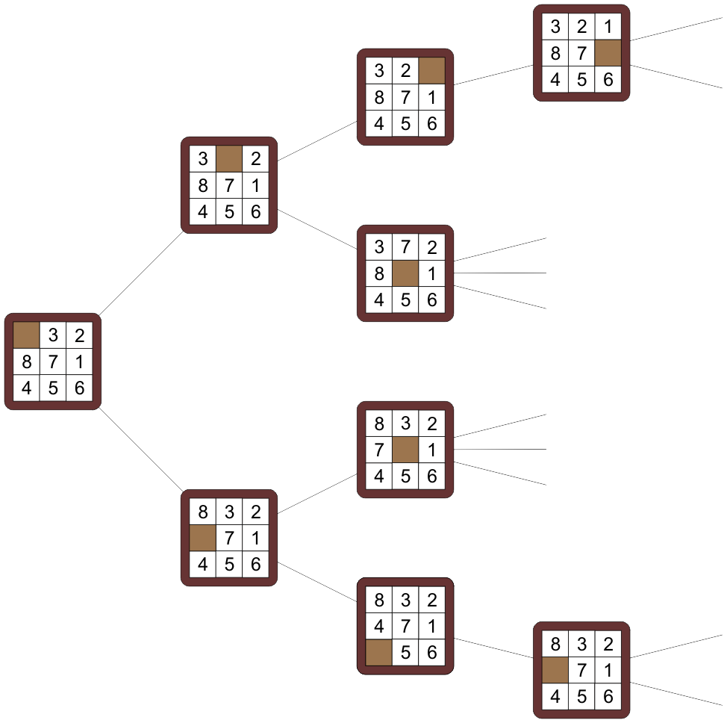
The N Puzzle
Each solution defines a vertex in a graph with edges denoting allowable moves
It is not a tree, but the smallest cycle has a length of 12
E.g., cycle 8, 7, and 3
Notes:
30

Slide 31
The N Puzzle
The graph of solvable eight puzzles has:
181 440 vertices
241 920 edges
The fifteen puzzle graph has:
10 461 394 944 000 vertices
15 692 092 416 000 edges
In general and in the limit:
(N + 1)!/2 vertices
(N + 1)! edges
Notes:
31

Slide 32
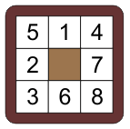
The N Puzzle
Finding a solution requires one to find the shortest path
All edges have weight 1
Dijkstra’s algorithm is painfully slow
This puzzle requires that 179680 vertices be searched
To use the A* search, we need a heuristic lower bound on the distance
Notes:
32

Slide 33
The N Puzzle
We will consider three distances which we will use with the A* search:
The discrete distance
If two objects are equal, the distance is 0, otherwise it is 1
The Hamming distance
The number of tiles (including the blank) which are in an incorrect location
The Manhattan distance
The sum of the minimum number of moves required to put a tile in its correct location
Notes:
33

Slide 34
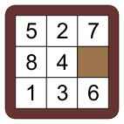
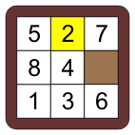
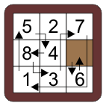
The N Puzzle
For example, consider this permutation:
It does not equal the solution, so the discrete distance is 1
8 out of 9 tiles/blanks are in the incorrect location; therefore the Hamming distance is 8
It requires 2 + 0 + 4 + 2 + 1 + 1 + 2 + 3 + 1 = 16 moves to move each tile into the correct location, therefore the Manhattan distance is 16

Slide 35
The N Puzzle
As discussed before, the discrete distance does not improve the situation: it is equivalent to Dijkstra’s algorithm
Using the same permutation as before:
The Hamming distance isn’t much better:
It reduces the vertices searched from 179 680 to 178 005
It is only useful when we are very close to the actual solution
The Manhattan distance, however, allows the A* search to find the minimal path with only 6453 vertices searched

Slide 36
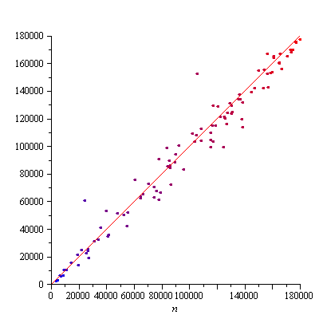
The N Puzzle
How much better is it to use the Manhattan distance over the Hamming or discrete?
With the Hamming distance, there is only a small change
For 100 random puzzles, we have a plot the number of vertices visited using the discrete distance versus the number of vertices visited using the Hamming distance
The line is the identity function
The colour, blue to red, indicates the length of the solution; from 13 to 28

Slide 37
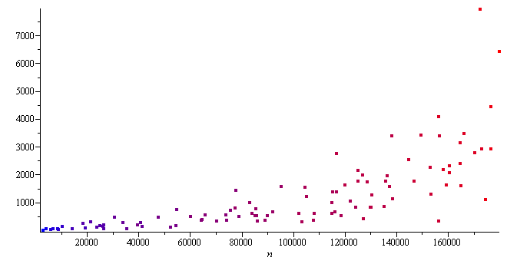
The N Puzzle
However, comparing the number of vertices visited when using the Manhattan distance, there is a significant reduction by a factor of almost 100
A more significant improvement with shorter paths

Slide 38
The N Puzzle
An implementation of N puzzles are located at
http://ece.uwaterloo.ca/~dwharder/aads/Algorithms/N_puzzles/
This includes:
An N puzzle class: N_puzzle<int N>
An updatable heap class: Updatable_heap<typename T, int M>

Slide 39
Summary
This topic has presented the A* search algorithm
Assumes a hypothetical lower bound on the length of the path to the destination
Requires an appropriate heuristic
Useful for Euclidean spaces (vector spaces with a norm)
Faster than Dijkstra’s algorithm in many cases
Directs searches towards the solution

Slide 40
References
Wikipedia, http://en.wikipedia.org/wiki/A*_search_algorithm
[1] Andrew Moore, Carnegie Mellon University, “A* Heuristic Search”, http://www.autonlab.org/tutorials/astar08.pdf
[2] Stuart Russell and Peter Norvig, Artificial Intelligence: A Modern Approach, 2nd Ed., Prentice Hall, Chapters 4 and 5.
These slides are provided for the ECE 250 Algorithms and Data Structures course. The material in it reflects Douglas W. Harder’s best judgment in light of the information available to him at the time of preparation. Any reliance on these course slides by any party for any other purpose are the responsibility of such parties. Douglas W. Harder accepts no responsibility for damages, if any, suffered by any party as a result of decisions made or actions based on these course slides for any other purpose than that for which it was intended.

